Slide 1


Intro to FakeXrmEasy
Overview of Test Driven Development of CDS (Common Data Service)

Slide 2



About Me
Jordi Montaña
jordi@dynamicsvalue.com
https://es.linkedin.com/in/jordimontana
14+ years dev experience
2x Microsoft MVP
Author of FakeXrmEasy:
leading OSS framework for unit testing

Slide 3

Why Unit Testing?

Slide 4
Why Unit Testing??

Slide 5

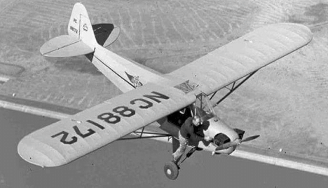
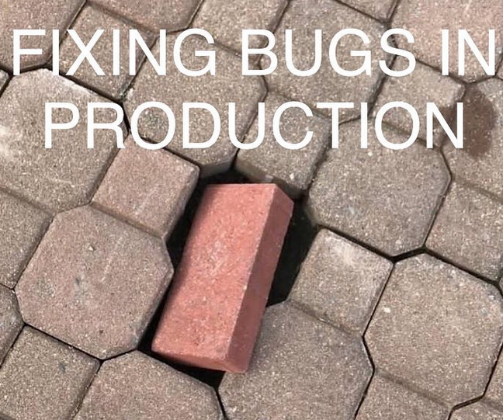


Why Unit Testing…?

Slide 6
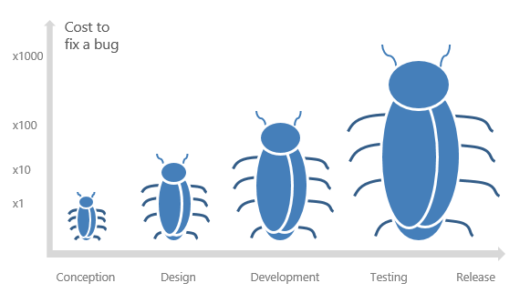
Why Unit Testing...
Proactive as opposed to Reactive
Bring issues closer to devs (us) where they’re easier and more cost effective to fix

Slide 7




What is FakeXrmEasy?
OSS Framework
190 Stars
146 forks
Aimed at developers using .net and Power Platform / CDS
Forks are like “copies” of the project
46 contributors
5+ Years
980k downloads
Who submitted at least 1 Pull Request
Started back in November 2014… time flies
Not too bad for a “low code” platform :)

Slide 8
FakeXrmEasy Roadmap
TODAY | Phase I (Imminent) | Phase II | Phase III
v1.x: - Production Ready - Full .NET Framework - Both server & client applications - Windows dev only “Code freeze” until 2.x alpha is out | v2.x (alpha) - .net core 3.1 support - xplat - dockerisation - Serverless - Mostly depends on CdsServiceClient by MS (also in Alpha) v1.x: Gradually “Merge” latest 1.x improvements / fixes to 2.x | v2.x (rc/prod) - Once CdsServiceClient reaches a stable version we can finally say v2.x can also became a rather stable package v1.x enters “deprecated” status | v2.x becomes mainstream v1.x is finally retired

Slide 9
How it works?
AAA Pattern
Arrange: we define our initial state
Act: we act on that state, possibly by changing it to fulfill our business requirements
Assert: we verify the final state is the desired state

Slide 10
How it works?… in the context of FakeXrmEasy
Assume a very simple piece of logic to update a contact’s first name.
Arrange: ctx.Initialize(new Contact() { Id = contactId, FirstName = “Steve” });
Act: service.Update(new Contact() { Id = contactId, FirstName=”Satya”})
Assert: Assert.Equals(“Satya”,ctx.CreateQuery<Contact>().FirstOrDefault().FirstName)

Slide 11
DEMO
https://github.com/DynamicsValue/malaysia-bizappug-intro-to-fake-xrm-easy

Slide 12

Q & A

Slide 13

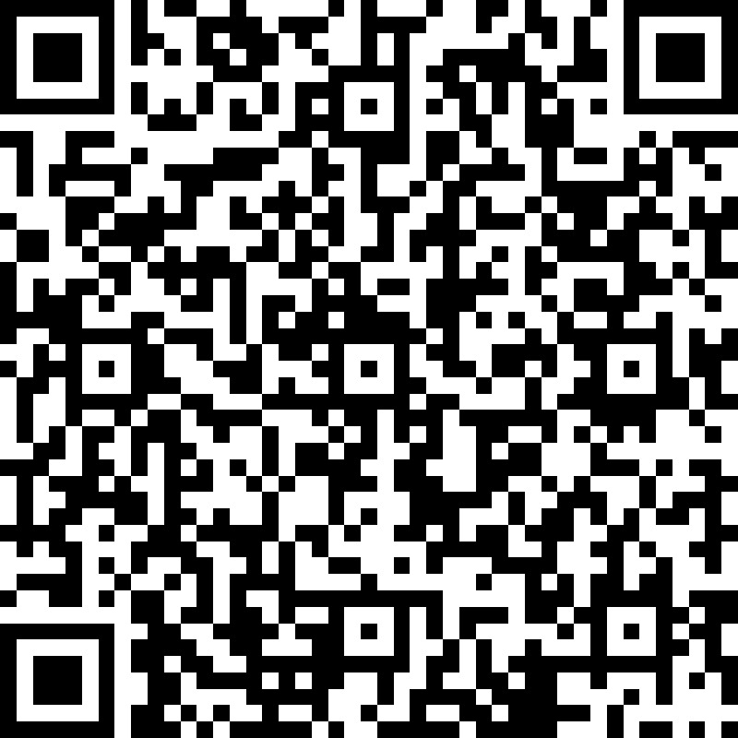
Your feedback matters…
https://bit.ly/35YthEQ

Slide 14



Thank You
Jordi Montaña
jordi@dynamicsvalue.com
https://dynamicsvalue.com

